Slide 1
Introduction to components

Slide 2
Introduction to components
Resistors
Diodes
Capacitors
Transistors
sensors
ICs/OP amps
Microcontrollers
Motors

Slide 3
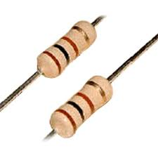
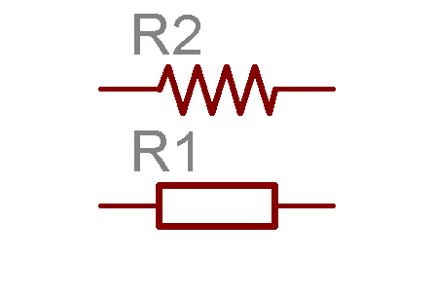
Resistors
Basic idea
Symbols
Dropping voltage
Controlling current

Slide 4
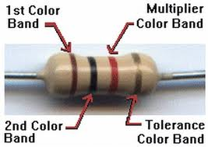
Resistors
Reading value
Color bands
Color code
Wattage

Slide 5
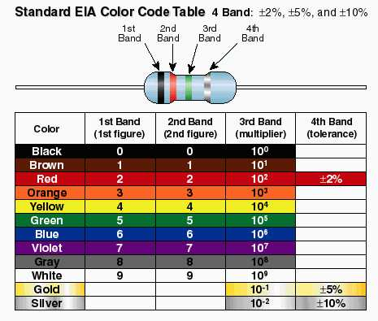

Slide 6
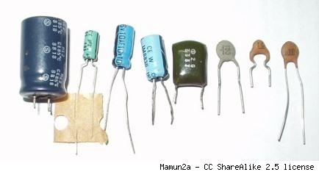
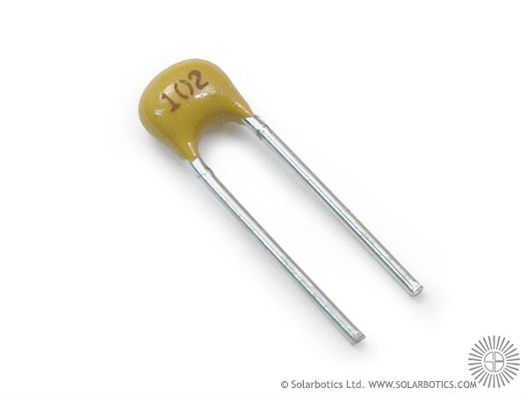
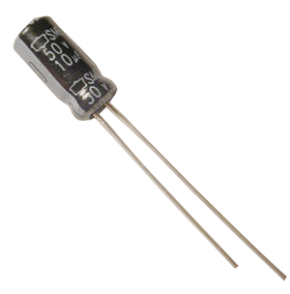
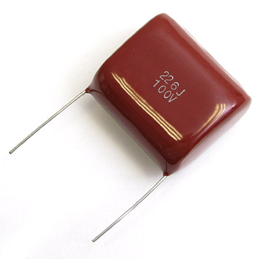
Capacitors
Introduction
Storing charge
Release it when needed

Slide 7
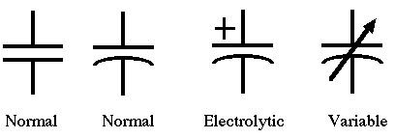

Capacitor - symbols

Slide 8

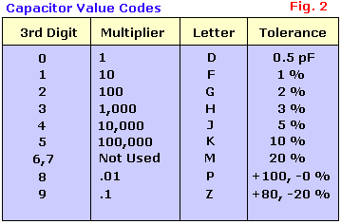
Reading values

Slide 9
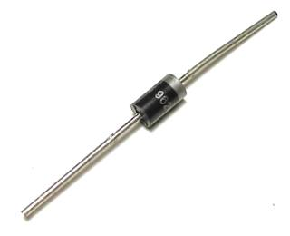
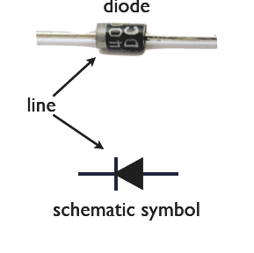
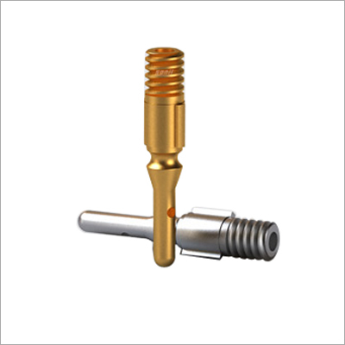
Diodes
Electronic valve
symbols

Slide 10
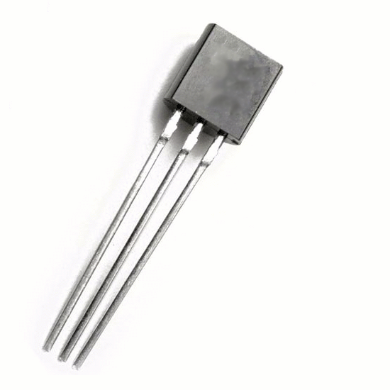
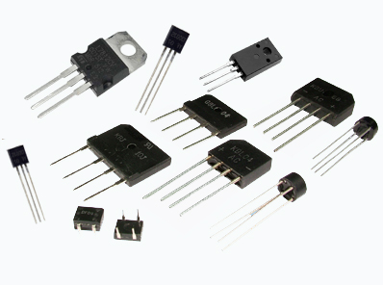
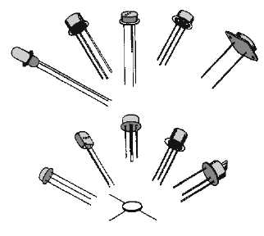
Transistors
Amplifier/ switch
Identification

Slide 11
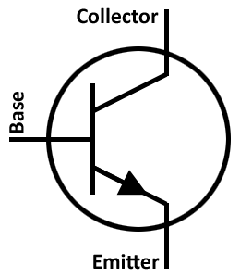

Symbols
npn – pnp

Slide 12
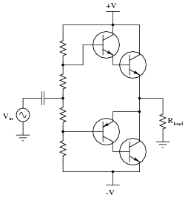
In circuit identification

Slide 13
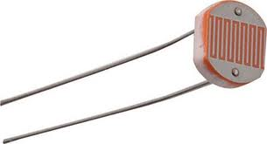
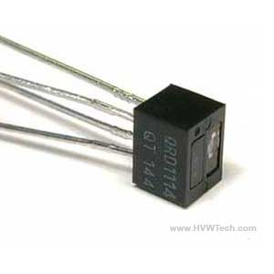
Sensors
Sense a particular frequency
IR / Light
Varies resistance according to sense

Slide 14
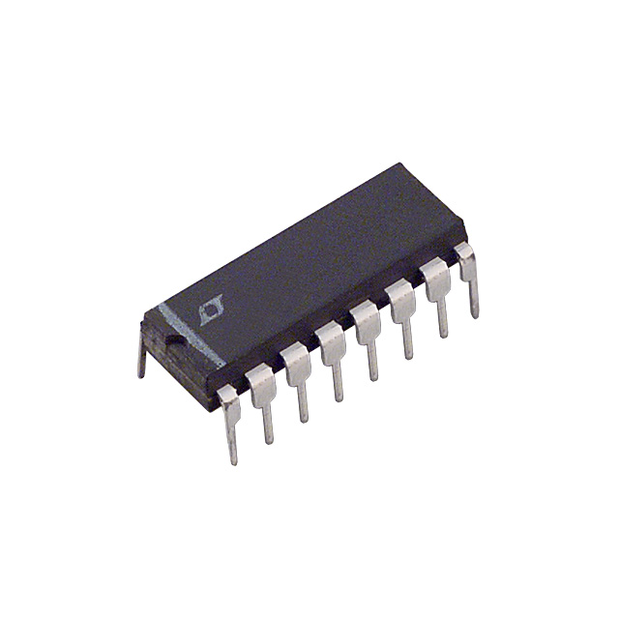
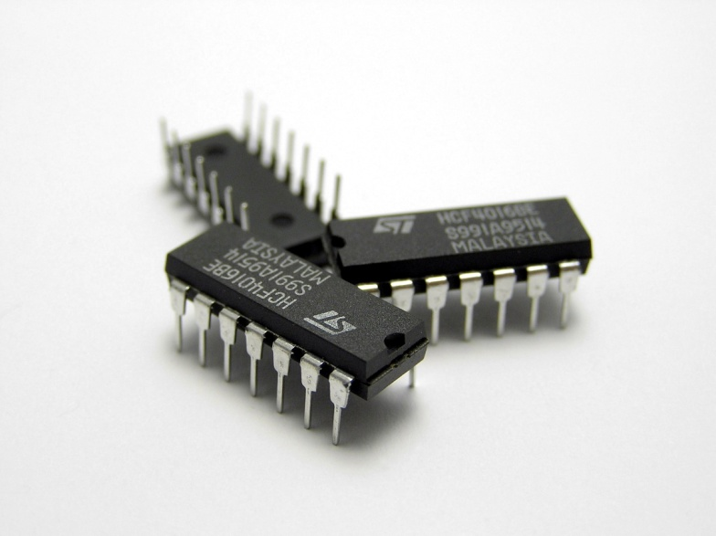
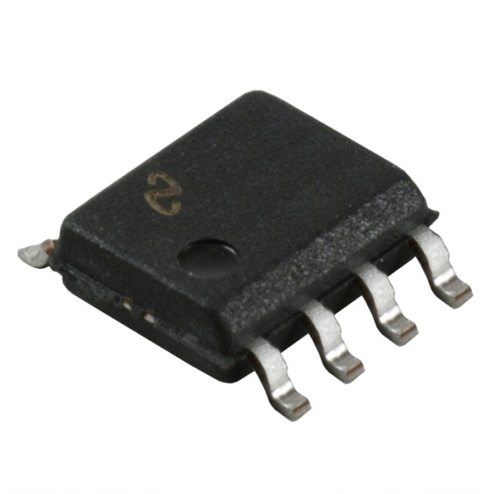
Integrated Circuits
Millions of transistors together

Slide 15
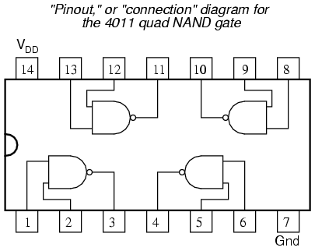
Internal structure

Slide 16
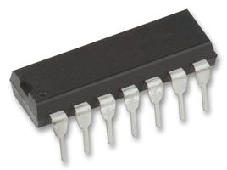
Pin identification

Slide 17
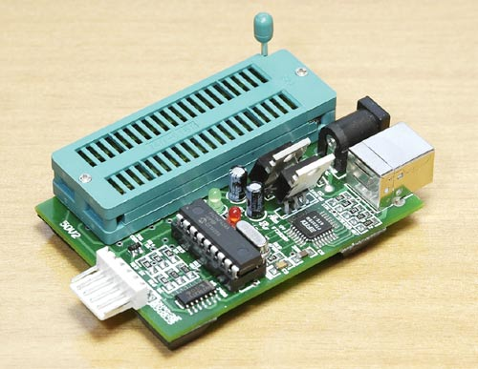
Microcontrollers
Programmable IC
Can be programmed
Pins to input data
Pins to out put data
Commonly used types

Slide 18
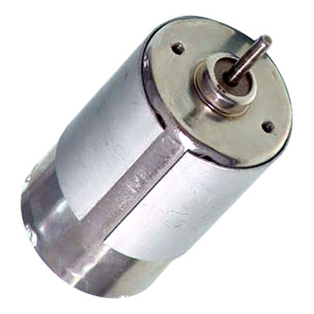
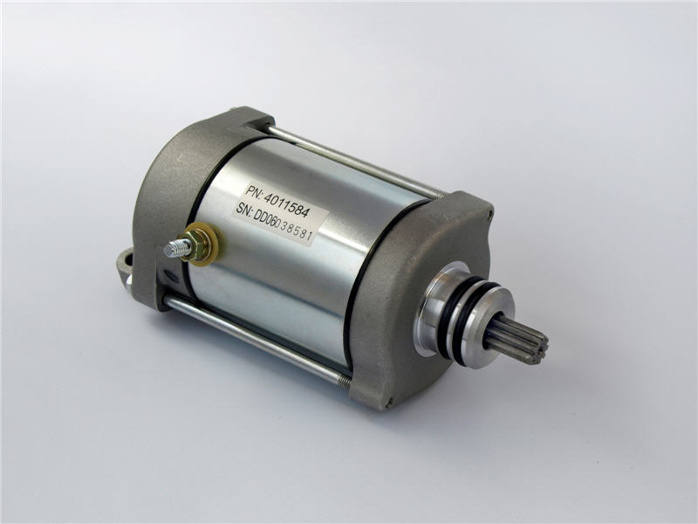
Geared Motors
Used to drive the robot
3 inputs
Direction/Ground
Operated by DC voltage

